Slide 1

Implementing Linux in Educational Institutions
This presentation explores the benefits of implementing the Linux operating system in educational institutions, outlining the reasons for choosing Linux, a comprehensive implementation strategy, and the impact on students and faculty.
AS
by Arati Sathe

Slide 2
Why Choose Linux?
Cost-Effectiveness
Security
Performance
Linux is open-source and free to use, eliminating licensing fees associated with proprietary operating systems like Windows and macOS.
Linux is less vulnerable to viruses and malware due to its robust security model.
It runs efficiently on older hardware, extending the lifespan of existing devices.

Slide 3

Implementation Strategy: Requirement Analysis
1
Understanding Needs
Identify the institution's specific needs, such as computer labs for programming, server requirements for hosting applications, and student and faculty workstations.
2
Survey Users
Gather feedback from students, teachers, and IT staff regarding preferred software, system compatibility, and training requirements.

Slide 4
Choosing the Right Linux Distribution
Ubuntu
Fedora
Debian
Best for general use, user-friendly.
Cutting-edge, good for development.
Stable, widely used for servers.
Linux Mint
Kali Linux
Best for transitioning from Windows.
For cybersecurity labs.

Slide 5

Training & Awareness
Workshops & Sessions
IT Support
Conduct workshops and hands-on sessions to familiarize users with the Linux environment.
Assign IT support staff to assist in the transition and address any technical challenges.
1
2
3
Documentation & Tutorials
Provide comprehensive documentation and video tutorials for self-paced learning.

Slide 6
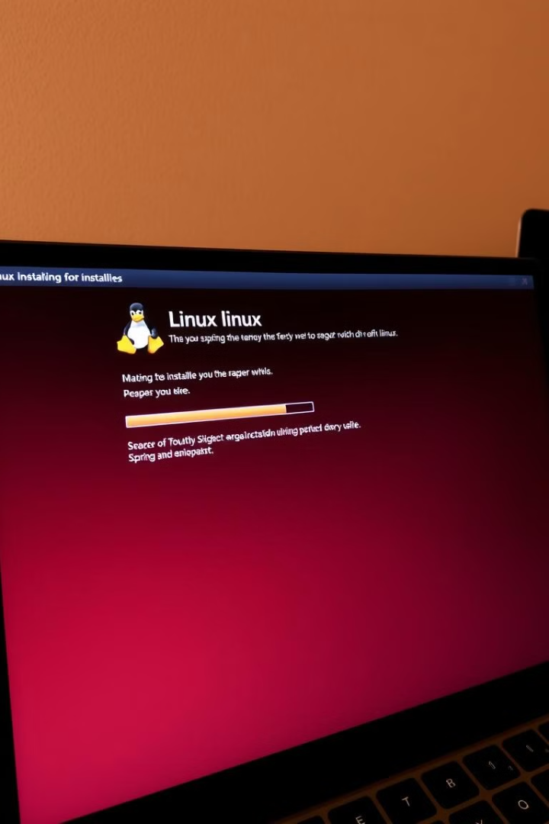



Installation & Configuration
Testing Phase
Deployment Strategy
Server Setup
Install Linux OS on a few systems for pilot testing.
Configure Linux-based servers for institution needs (file sharing, web hosting, etc.).
Consider dual boot setup if users still need Windows or full migration if shifting entirely to Linux.

Slide 7
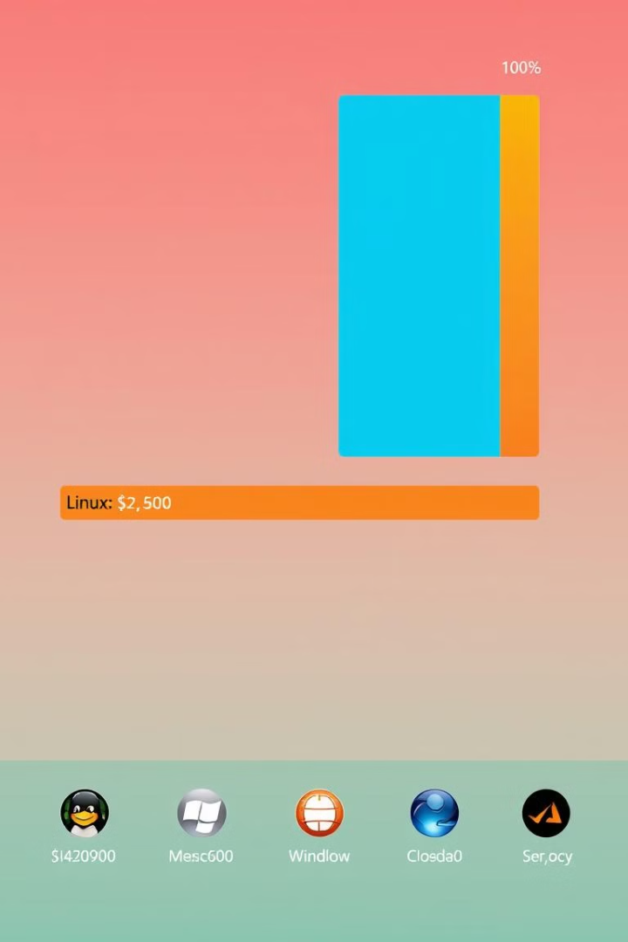




Cost Considerations
Software Costs
Free, as Linux and its software ecosystem are open-source.
Hardware Costs
Minimal if existing computers are used; otherwise, budget for new hardware.
Training & Support
Initial training may require investment, but long-term support is cost-effective.
Maintenance
Lower than proprietary OS due to fewer security vulnerabilities and community support.

Slide 8




Impact on Students & Faculty
Hands-on Experience
1
Linux provides real-world computing experience in programming and system administration.
Skill Development
2
Enhances problem-solving and technical skills.
Industry Readiness
3
Many IT companies use Linux, making students industry-ready.
Project-Based Learning
4
Encourages students to contribute to open-source projects.

